Slide 1

CISSP (Certified Information Systems Security Professional)
Kelly Handerhan, Subject Matter Expert
kellyhanderhan@gmail.com
CASP, CISSP, PMP

Slide 2
The 10 Domains of CISSP
CISSP Course Syllabus
Chapter 1: Information Security Governance and Risk Management
Chapter 2: Operations Security
Chapter 3: Cryptography
Chapter 4: Access Control
Chapter 5: Physical Security
Chapter 6: Telecommunications
Chapter 7: Legal, Ethics and Investigations
Chapter 8: Software Development Security
Chapter 9: Business Continuity and Disaster Recovery Planning
Chapter 10: Security Architecture and Design

Slide 3
Exam Specifics
250 Questions (25 are “beta” and are not graded)
6 hours to complete the exam
You can mark questions for review
You will be provided with 1“wipe” board 8x11 and a pen. materials. You will also have access to an on-screen calculator.
Many test centers provide earplugs or noise cancelling head phones. Call your center ahead of time to verify
Questions are weighted (Remember…security transcends technology)

Slide 4
The CISSP Mindset
Your Role is a Risk Advisor
Do NOT fix Problems
Who is responsible for security?
How much security is enough?
All decisions start with risk management. Risk management starts with Identifying/Valuating your assets.
“Security Transcends Technology”
Physical safety is always the first choice
Technical Questions are for Managers. Management questions are for technicians
Incorporate security into the design, as opposed to adding it on later
Layered Defense!

Slide 5
Test Taking Tips
If you haven’t already, SCHEDULE THE TEST!!!
Start with the question mark. Often the beginning of the scenario is a distraction
Choose an answer for EVERY question. Even those you mark for review, just in case you run out of time.
Be cautious about changing answers. Your first instinct is often right. Trust yourself and your knowledge and what we do in class. Don’t second guess!
Take Breaks as needed. Plan on 50 questions per hour.

Slide 6

Information Security and Risk Management

Slide 7
Agenda
Fundamentals of Security
Types of Attacks
Risk Management
Security Blueprints
Policies, Standards, Procedures, Guidelines
Roles and Responsibilities
SLAs
Data Classification
Certification Accreditation and Auditing
Knowledge Transfer

Slide 8
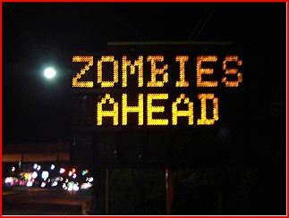
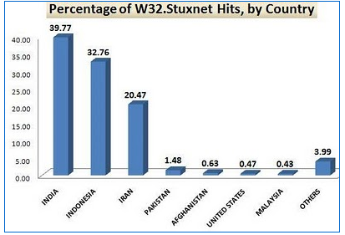
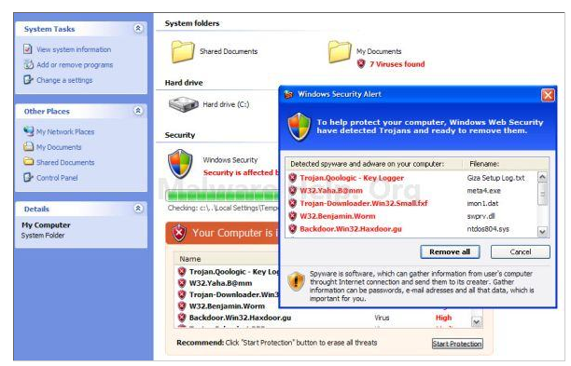
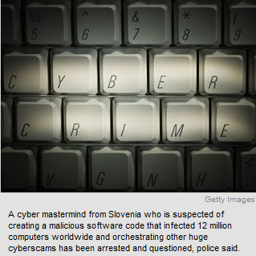
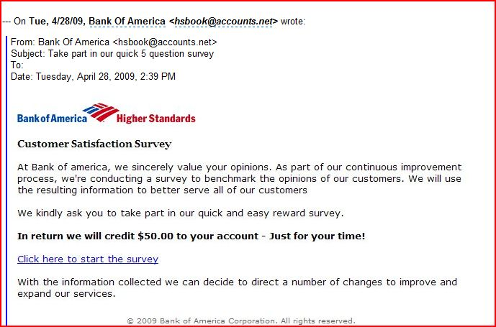
Well Known Exploits
Notes:
Computing technology is not restricted to Mainframe and PC’s anymore. Both simple and advanced devices are now part of our everyday life, ranging from road signs to intelligent vending machines to advanced diagnosing medical services. Each of these new types of devices needs to be secured, since they all have their own requirements regarding Confidentiality, Integrity and Availability of the data or resources they provide. In the slide above, very simple means could have been used to secure this road sign. However, due to lack of Physical, Administrative and Technical Controls, the sign was compromised. This not only proved to be an embarrassment to the Department of Transportation, but a reminder that all systems can be exploited without the proper controls in place. Stuxnet has gained world-wide attention in its penetration of Iran’s nuclear plants. Other exploits like the Windows 7 “security center” fake anti-virus program, as well as cross-site scripting and phishing emails result in the infection of tens of thousands of machines each year. It is for this reason that IT security is a field in such high demand.

Slide 9
The Role of Information Security Within an Organization
First priority is to support the mission of the organization
Requires judgment based on risk tolerance of organization, cost and benefit
Role of the security professional is that of a risk advisor, not a decision maker.

Slide 10
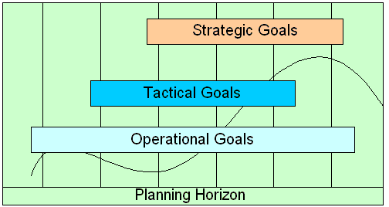

Planning Horizon
Strategic Goals
  Over-arching - supported by tactical goals and operational
Tactical Goals
  Mid-Term - lay the necessary foundation to accomplish Strategic Goals
Operational Goals
  Day-to-day - focus on productivity and task-oriented activities
Notes:
Goals of a Security Model
Strategy leads to Tactics; tactics lead to Operations.
Operational goals may be to patch computers, as they need them, support users, update anti-virus signatures, and maintain the overall network on a daily basis. Corresponding tactical goals could be to move computers into domains, install firewalls, and segregate the network by creating a demilitarized zone. Then, the strategic goals may be to have all domains centrally administered and implement VPNs and RADIUS servers to provide a highly secure environment that provides a good amount of assurance to the management and employees.
A security model has different layers, but it also has different types of goals to accomplish in different time frames. You might have a goal for yourself today to brush your teeth, run three miles, finish the project you have been working on, and spend time with your kids. These are daily goals or operational goals. You might have mid-term goals to complete your master’s degree, write a book, and get promoted. These are longer term goals and are referred to as tactical goals. Your long-term goals may be to retire at age 55, save enough money to live comfortably, and to live on a houseboat. These goals are strategic goals because they look farther into the future.
The same thing happens in computer security planning. Daily goals, or operational goals, focus on productivity and task-oriented activities to ensure the company’s functionality in a smooth and predictable manner. Mid-term goals, or tactical goals, could be to integrate all workstations and resources into one domain so more central control can be achieved. A long-term goal, or strategic goal, may involve moving all the branches from dedicated communication lines to frame relay, implementing IPSec virtual private networks (VPNs) for all remote users instead of dial-up entry, and integrating wireless technology with the necessary security measures into the environment.
This approach to planning is called the planning horizon. A company cannot usually implement all changes at once, and some changes are larger than others. Many times, certain changes cannot happen until other changes take place. If a company wants to implement its own certificate authority and wants to implement a full public key infrastructure (PKI) enterprise-wide, this cannot happen in a week if the company currently works in decentralized workgroups with no domain structure. The operational goals are to keep production running smooth and make small steps towards readying the environment for a domain structure. The tactical goal would be to put all workstations and resources into a domain structure and centralize access control and authentication. The strategic goal is to have all workstations, servers, and devices within the enterprise use the public key infrastructure to provide authentication, encryption, and more secure communication channels.
Security works best if it’s Operational, Tactical, and Strategic goals are defined and work to support each other. This can be more difficult than it appears.

Slide 11
Security Fundamentals
C-I-A Triad
  Confidentiality
  Integrity
  Availability

Slide 12
Confidentiality
Prevent unauthorized disclosure
  Social Engineering
    Training, Separation of Duties, Enforce Policies and Conduct Vulnerability Assessments
  Media Reuse
    Proper Sanitization Strategies
  Eavesdropping
    Encrypt
    Keep sensitive information off the network

Slide 13
Integrity
Detect modification of information
Corruption
Intentional or Malicious Modification
  Message Digest (Hash)
  MAC
  Digital Signatures

Slide 14
Availability
Provide Timely and reliable access to resources
  Redundancy, redundancy, redundancy
  Prevent single point of failure
  Comprehensive fault tolerance (Data, Hard Drives, Servers, Network Links, etc)

Slide 15
Best Practices (to protect C-I-A)
Separation of Duties (SOD)
Mandatory Vacations
Job rotation
Least privilege
Need to know
Dual control
Notes:
Separation of Duties: prevents any one person from becoming too powerful within an organization. This policy also provides singleness of focus. For instance, a network administrator who is concerned with providing users access to resources should never be the security administrator. This policy also helps prevent collusion as there are many individuals with discrete capabilities. Separation of Duties is a preventative control.
Mandatory Vacations: Prevents an operator from having exclusive use of a system. Periodically that individual is forced to take a vacation and relegate control of the system to someone else. This policy is a detective control.
Job rotation: Similar in purpose to mandatory vacations, but with the added benefit of cross-training employees.
Least privilege: Allowing users to have only the required access to do their jobs.
Need to know: In addition to clearance, users must also have “need to know” to access classified data.
Dual control: Requiring more than one user to perform a task. Mof N control, and split knowledge are types of dual control.

Slide 16
Defense in Depth
Also Known as layered Defense
No One Device will PREVENT an attacker
Three main types of controls:
  Technical (Logical)
  Administrative
  Physical

Slide 17
Risk
  Every decision starts with looking at risk
  Determine the value of your assets
  Look to identify the potential for loss
  Find cost effective solution reduce risk to an acceptable level (rarely can we eliminate risk)
  Safeguards are proactive
  Countermeasures are reactive

Slide 18
Risk Definitions
Asset: Anything of Value to the company
Vulnerability: A weakness; the absence of a safeguard
Threat: Something that could pose loss to all or part of an asset
Threat Agent: What carries out the attack
Exploit: An instance of compromise
Risk: The probability of a threat materializing
Controls: Physical, Administrative, and Technical Protections
  Safeguards
  Countermeasure

Slide 19
Sources of Risk
Weak or non-existing anti-virus software
Disgruntled employees
Poor physical security
Weak access control
No change management
No formal process for hardening systems
Lack of redundancy
Poorly trained users

Slide 20
Risk Management
Processes of identifying, analyzing, assessing, mitigating, or transferring risk. It’s main goal is the reduction of probability or impact of a risk.
Summary topic that includes all risk-related actions
Includes Assessment, Analysis, Mitigation, and Ongoing Risk Monitoring
Notes:
Risk Management
The success of a security program can be traced to a thorough understanding of risk. Without a proper consideration and evaluation of risks, the correct controls may not be implemented. Risk assessment insures that we identify and valuate our assets, then identify threats and their corresponding vulnerabilities. Risk analysis allows us to prioritize these risks and ultimately assign a dollar value to each risk event. Once we have a dollar value for a particular risk, we can then make an informed decision as to which mitigation method best suites our needs. And finally, as with all elements of a security policy, ongoing evaluation is essential. New attacks and other threats are always emerging, and security professionals must stay informed and up to date.

Slide 21
Risk Management
Risk Management
  Risk Assessment
    Identify and Valuate Assets
    Identify Threats and Vulnerabilities
  Risk Analysis
    Qualitative
    Quantitative
  Risk Mitigation/Response
    Reduce /Avoid
    Transfer
    Accept /Reject
Ongoing Risk Monitoring

Slide 22
Risk Assessment
Looks at risks for a specific period in time and must be reassessed periodically
Risk Management is an ongoing process
The following steps are part of a Risk Assessment per NIST 800-30
  System Characterization
  Threat Identification
  Vulnerability Identification
  Control Analysis
  Likelihood Determination
  Impact analysis
  Risk determination
  Control Recommendation
  Results Documentation

Slide 23
Risk Analysis
Determining a value for a risk
Qualitative vs. Quantitative
Risk Value is Probability * Impact
Probability: How likely is the threat to materialize?
Impact: How much damage will there be if it does?
  Could also be referred to as likelihood and severity.

Slide 24
Risk Analysis
Qualitative Analysis (subjective, judgment-based)
  Probability and Impact Matrix
Quantitative Analysis (objective, numbers driven
  AV (Asset Value)
  EF (Exposure Factor)
  ARO (Annual Rate of Occurrence)
  SLE (Single Loss Expectancy)=AV * EF
  ALE (Annual Loss Expectancy) SLE*ARO
  Cost of control should be the same or less than the potential for loss

Slide 25
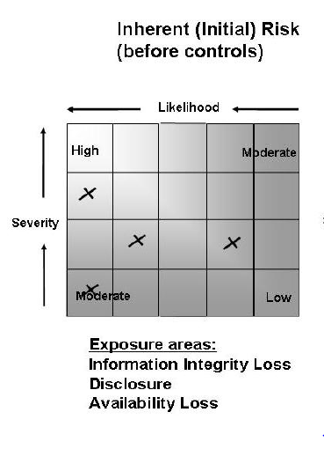
Qualitative Analysis
Subjective in Nature
Uses words like “high” “medium” “low” to describe likelihood and severity (or probability and impact) of a threat exposing a vulnerability
Delphi technique is often used to solicit objective opinions

Slide 26
Quantitative Analysis
More experience required than with Qualitative
Involves calculations to determine a dollar value associated with each risk event
Business Decisions are made on this type of analysis
Goal is to the dollar value of a risk and use that amount to determine what the best control is for a particular asset
Necessary for a cost/benefit analysis

Slide 27
Mitigating Risk
Three Acceptable Risk Responses:
  Reduce
  Transfer
  Accept
Secondary Risks
Residual Risks
Continue to monitor for risks
How we decide to mitigate business risks becomes the basis for Security Governance and Policy

Slide 28
Security Governance
The IT Governance Institute in its Board Briefing on IT Governance, 2nd Edition, defines Security governance as follows:
“Security governance is the set of responsibilities and practices exercised by the board and executive management with the goal of providing strategic direction, ensuring that objectives are achieved, ascertaining that risks are managed appropriately and verifying that the enterprise's resources are used responsibly.”
Notes:
The goal of security governance is to ensure that security strategies, goals, risks and objectives are assessed according to a top-down model. By following the Top-Down Model, we ensure that those ultimately responsible for the success or failures of a security program are directly involved.

Slide 29
Security Blueprints
For achieving “Security Governance”
BS 7799, ISO 17799, and 27000 Series
COBIT and COSO
OCTAVE
ITIL
Notes:
Security blueprints have been created to allow organizations to implement practices and procedures to support their security goals and the overall mission of the organizations. Various agencies have provided insight in the goals, objectives and means of developing successful Information Security Management Systems (ISMS).

Slide 30
COBIT and COSO
COBIT (Control Objectives for Information and related Technology.
COSO (Committee of Sponsoring Organizations)
Notes:
COBIT is a set of best practices created and controlled through the Information Systems Audit and Control Association (ISACA) and IT Governance Institute (ITGI). It defines the goals for the controls that should be in place in order to secure an organization's resources. Further, COBIT is broken down into 4 domains:
Plan and Organize
Acquire and Implement
Deliver and Support
Monitor and Evaluate
COBIT does not provide a “how to”, but merely an approach. The “how to” can be found in the ISO 27000 series.
COSO provides a model for corporate governance, where as COBIT is directed specifically towards IT. COBIT is a subset of COSO

Slide 31
ITIL
Information Technology Infrastructure Library (ITIL) is the de facto standard for best practices for IT service managmenet
5 Service Management Publications:
  Strategy
  Design
  Transition
  Operation
  Continual Improvement
**While the Publications of ITIL are not testable, it's purpose and comprehensive approach are testable. It provides best practices for organization and the means in which to implement those practices

Slide 32
OCTAVE
Operationally Critical Threat, Asset and Vulnerability Evaluation
Self Directed risk evaluation developed by Carnegie Mellon. People within an organization are the ones who direct the risk analysis
A suite of tools, techniques, and methods for risk-based information security strategic assessment and planning.
1. Identify Assets
2. Identify Vulnerabilities
3. Risk Analysis and Mitigation

Slide 33
BS 7799, ISO 17799, 27000 Series
BS 7799-1, BS 7799-2
Absorbed by ISO 17799
Renamed ISO 27002 to fit into the ISO numbering standard
Notes:
BS 7799 was an internationally recognized ISM (Information Security Management Standard, which actually had two parts: 7799-1 and 7799-2. Part 1 outlines objectives in regards to security controls. Part 2 provides outline for how to meet Security needs and the implementation of those controls in a way in which company objectives are met.
ISO adopted this standard years later as ISO 17799 standard. Companies could be certified against this standard as a way to inspire trust in their security infrastructure.
ISO renamed 17799 to 27002 to correspond with their current numbering system in place, and to fit in to the ISO 27000 series.

Slide 34
ISO 27000 Series
ISO 27001: Establishment, Implementation, Control and improvement of the ISMS. Follows the PDCA (Plan, Do, Check, Act)
ISO 27002: Replaced ISO 17799. Provides practical advice for how to implement security controls. Uses 10 domains to address ISMS.
ISO 27004: Provides Metrics for measuring the success of ISMS
ISO 27005: A standards based approach to risk management
ISO 27799: Directives on protecting personal health information
Notes:
ISO 27001
The ISO 27001 standard was published in October 2005, essentially replacing the old BS7799-2 standard. It is the specification for an ISMS, an Information Security Management System. BS7799 itself was a long standing standard, first published in the nineties as a code of practice. As this matured, a second part emerged to cover management systems. It is this against which certification is granted. Today in excess of a thousand certificates are in place, across the world.
ISO 27001 enhanced the content of BS7799-2 and harmonized it with other standards. A scheme has been introduced by various certification bodies for conversion from BS7799 certification to ISO27001 certification.
The objective of the standard itself is to "provide a model for establishing, implementing, operating, monitoring, reviewing, maintaining, and improving an Information Security Management System". Regarding its adoption, this should be a strategic decision. Further, "The design and implementation of an organization's ISMS is influenced by their needs and objectives, security requirements, the process employed and the size and structure of the organization".
The standard defines its 'process approach' as "The application of a system of processes within an organization, together with the identification and interactions of these processes, and their management". It employs the PDCA, Plan-Do-Check-Act model to structure the processes
ISO/IEC 27001 requires that management:
Systematically examine the organization's information security risks, taking account of the threats, vulnerabilities and impacts;
Design and implement a coherent and comprehensive suite of information security controls and/or other forms of risk treatment (such as risk avoidance or risk transfer) to address those risks that are deemed unacceptable; and
Adopt an overarching management process to ensure that the information security controls continue to meet the organization's information security needs on an ongoing basis.
ISO 27002
The ISO 27002 standard is the rename of the ISO 17799 standard, and is a code of practice for information security. It basically outlines hundreds of potential controls and control mechanisms, which may be implemented, in theory, subject to the guidance provided within ISO 27001.
ISO/IEC 27002 provides best practice recommendations on information security management for use by those who are responsible for initiating, implementing or maintaining Information Security Management Systems (ISMS). Information security is defined within the standard in the context of the C-I-A triad:
The standard "established guidelines and general principles for initiating, implementing, maintaining, and improving information security management within an organization". The actual controls listed in the standard are intended to address the specific requirements identified via a formal risk assessment. The standard is also intended to provide a guide for the development of "organizational security standards and effective security management practices and to help build confidence in inter-organizational activities".
The basis of the standard was originally a document published by the UK government, which became a standard 'proper' in 1995, when it was re-published by BSI as BS7799. In 2000 it was again re-published, this time by ISO ,as ISO 17799. A new version of this appeared in 2005, along with a new publication, ISO 27001. These two documents are intended to be used together, with one complimenting the other.
Information Security Policy
Creation of information security infrastructure
Asset classification and control
Personnel security
Physical and environmental security
Communications and operations management
Access control
System development and maintenance
Business continuity management
Compliance
ISO/IEC 27005, part of a growing family of ISO/IEC ISMS standards, the 'ISO/IEC 27000 series', is an information security standard published by the International Organization for Standardization (ISO) and the International Electrotechnical Commission (IEC). Its full title is ISO/IEC 27005:2008 Information technology -- Security techniques -- Information security risk management.
The purpose of ISO/IEC 27005 is to provide guidelines for information security risk management. It supports the general concepts specified in ISO/IEC 27001 and is designed to assist the satisfactory implementation of information security based on a risk management approach. It does not specify, recommend or even name any specific risk analysis method, although it does specify a structured, systematic and rigorous process from analyzing risks to creating the risk treatment plan.
The standard was published in June 2008.

Slide 35
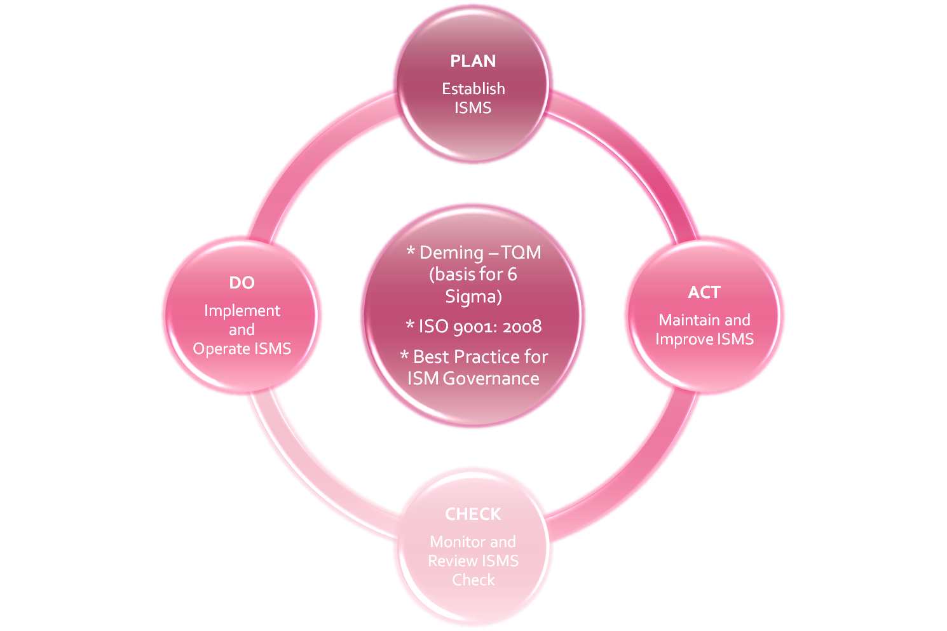





The Plan Do Check Act (PDCA) Model
INTERESTED
PARTIES
Information
Security
Requirements
And
Expectations
INTERESTED
PARTIES
Managed
Information
Security
Notes:
PDCA
PDCA is an approach to continuous process improvement used in both ISO 9001 and TQM.
The International Organization for Standardization (ISO) 9000 Standard Series is a set of international quality management standards and guidelines. Since their initial publication in 1987, they have earned a global reputation as the basis for establishing quality management systems (QMS). The revised ISO 9001 is intended to be generic, and independent of any specific industry or economic sector. It will be applicable to all types and sizes of organizations. ISO 9001's quality management system requirements are intended to be complementary to specified technical requirements for products and/or services. (NIST)

Slide 36


Approach to Security Management
Top-Down Approach
Security practices are directed and supported at the senior management level
Bottom-Up Approach
The IT department tries to implement security
Senior Management
Senior Management
Middle Management
Middle Management
Staff
Staff
Notes:
Approach to Security Management
Poor security management causes the majority of a company’s security problems. Security needs to be directed and supported from top management, referred to as the top-down approach, because without that, any security efforts will be doomed. Unfortunately, most companies follow a bottom-up approach, where the IT department takes security seriously and attempts to develop a security program. This approach usually will not provide those individuals with the necessary funds, support, resources, or attention. Thus, it is often doomed from the start.

Slide 37
Information Security Management Program
Senior management's Involvement
Governance
Policies/Standards/Procedures/Guidelines
Roles and Responsibilities
SLA's Service Level Agreements/Outsourcing
Data Classification/Securitiy
C&A (Certification and Accreditation
Auditing
Notes:
Information on each of the above bullet points on the following pages.

Slide 38
Senior Management Role
CEO, CSO, CIO, etc
  Ultimately responsible for Security within an organization
  Development and Support of Policies
  Allocation of Resources
  Decisions based on Risk
  Prioritization of business processes
Notes:
Development and Support of Policies: Senior Management is responsible for the company-wide policies within an organization. These policies should be high-level statements from management that detail the company's philosophy and commitment to security. Additionally, it is management's responsibility to ensure the enforcement of these policies, and to lead by example.
Allocations of Resources: Senior Management is also responsible for providing the necessary resources to able policy to be carried out. A true understanding of issues regarding liability are necessary in order to justify the resources.
Decisions based on Risk: It is Senior Management's task to be the ultimate decision-makers for the organization. Once provided with the facts from a risk analysis, it is up to Management to make decisions on forms of Risk Mitigation

Slide 39
Liabilities
Legal liability is an important consideration for risk assessment and analysis.
Addresses whether or not a company is responsible for specific actions or inaction.
Who is responsible for the security within an organization?
  Senior management
Are we liable in the instance of a loss?
  Due diligence: Continuously monitoring an organizations practices to ensure they are meeting/exceeding the security requirements.
  Due care: Ensuring that “best practices” are implemented and followed. Following up Due Diligence with action.
  Prudent man rule: Acting responsibly and cautiously as a prudent man would
  Best practices: Organizations are aligned with the favored practices within an industry
Notes:
Due Care and Due Diligence
The information owner, senior management, has the responsibility of classifying data, dictating how it will be protected, and ensuring that only the necessary individuals access it. If anything happens to the data, they are ultimately responsible.
The owners are expected to practice due care. Due care means to take the necessary steps to protect assets, as in installing anti-virus or intrusion detection system (IDS) software.
Due diligence is the act of investigating and understanding the risks the company faces.
A company practices due care by developing security policies, procedures, and standards. Due care shows that a company has taken responsibility for the activities that take place within the corporation and has taken the necessary steps to help protect the company, its resources, and employees from possible risks.
Thus, due diligence is understanding the current threats and risks, and due care is implementing countermeasures to provide protection from those threats. If a company does not practice due care and due diligence pertaining to the security of its assets, it can be legally charged with negligence and held accountable for any ramifications of that negligence.
If a security incident took place and it was found that the information owner was not practicing due care, then liability could easily lie at his doorstep.

Slide 40
Organizational Security Policy
aka Program Policy
Mandatory
High level statement from management
Should support strategic goals of an organization
Explain any legislation or industry specific drivers
Assigns responsibility
Should be integrated into all business functions
Enforcement and Accountability
Notes:
Security Policy: The organization’s security policy is a high-level document that contains generalized terms of management’s directive pertaining to security’s role within the organization. It establishes how a security program will be set up, dictates the program’s goals, assigns responsibility, shows the background, and explains the strategic and tactical values of security. It explains how enforcement will be carried out and addresses laws and regulations that it fulfills. It will provide scope and direction for all future activities within the organization. After the security policy is defined, the next step is creating the standards, guidelines, procedures, baselines, etc. The Security Policy should always support the strategic goals of the organization.

Slide 41
Issue and System Specific Policy
Issue Specific policy, sometimes called Functional Implementation policy would include company's stance on various employee issues. AUP, Email, Privacy would all be covered under issue specific
System Specific policy is geared toward the use of network and system resources. Approved software lists, use of firewalls, IDS, Scanners,etc

Slide 42
Other Types of Policies
Regulatory
Advisory
Informative
Notes:
Regulatory: Based on industry standards or government regulations. These policies are mandatory
Advisory: Details to employees what behaviors are and are not acceptable within an organization. Enforcement of policy and how violations are handled are also addressed.
Informative: Not an enforceable policy, but one that teaches employees about topics of interest from a management standpoint.

Slide 43

Security Policy Document Relationships
Laws, Regulations
and Best Practices
Drivers
Management’s Security Statement
Program or Organizational Policy
Functional (Issue and
System Specific) Policies
Management’s
Security Directives
Standards
Procedures
Baselines
Guidelines
Notes:
Laws, Industry Standards and Best Practices are drivers for the formation of an Organizational policy. The organizational policy will give way to issue and/or system specific policies, which then give foundation to standards, procedures, baselines and guidelines. Without each of these elements, administrative security controls are incomplete.

Slide 44
Standards
Mandatory
Created to support policy, while providing more specifics.
Reinforces policy and provides direction
Can be internal or external

Slide 45
Procedures
Mandatory
Step by step directives on how to accomplish an end-result.
Detail the “how-to” of meeting the policy, standards and guidelines

Slide 46
Guidelines
Not Mandatory
Suggestive in Nature
Recommended actions and guides to users
“Best Practices”

Slide 47
Baselines
Mandatory
Minimum acceptable security configuration for a system or process
The purpose of security classification is to determine and assign the necessary baseline configuration to protect the data

Slide 48
Personnel Security Policies (examples)
Hiring Practices and Procedures
Background Checks/Screening
NDA's
Employee Handbooks
Formal Job Descriptions
Accountability
Termination

Slide 49
Roles and Responsibilities
Senior/Executive Management
  CEO: Chief Decision-Maker
  CFO: Responsible for budgeting and finances
  CIO: Ensures technology supports company's objectives
  ISO: Risk Analysis and Mitigation
Steering Committee: Define risks, objectives and approaches
Auditors: Evaluates business processes
Data Owner: Classifies Data
Data Custodian: Day to day maintenance of data
Network Administrator: Ensures availability of network resources
Security Administrator: Responsible for all security-related tasks, focusing on Confidentiality and Integrity
Notes:
CEO (Chief Executive Officer): Responsible for the function of the organization's daily operations. Oversees finances, operations and strategic planning from the upper level. This is the highest role within an organization.
CFO (Chief financial Officer): Responsible for account and financial activities and the financial structure of the organization. He/She will also oversee the forecasting, budgeting and presentation of financial statements to SEC
CIO (Chief Information Officer): A strategic position designed to architect the use and management of IS and technology within the organization
ISO (Information Security Officer): Primarily responsible for Risk Analysis and Risk mitigation. The ISO should understand the organization's strategic goals and implement and maintain a security program that will support this goals. The ISO reports to the CIO.
Steering Committee: Made up of individuals representing key business units within the organization: Their job is to Define the acceptable risk level for the company, develop security objectives and approaches, monitor the impact of security risks, approve any major changes to the security policy and program.
Auditors: Appointed by Board of Directors or Senior management with the responsibilities of evaluating the business processes, internal audit system and the accuracy of financial data
Data Owner: Responsible for the classification of data, as well as ensuring the accuracy and integrity of this data
Data Custodian: Responsible for the day-to-day maintenance of the data and for implementing the classification specified by the data owner.
Change Control Board (CCB) Evaluation and Approval/Denial of change requests as part of an integrated change control process.
Network Administrator: Responsible for the functionality of the network, with availability as his/her primary goal.
Security Administrator: All system related tasks. The primary function of the Security Administrator is to protect the confidentiality and integrity of network resources. This role is responsible for the following tasks:
Creating new user accounts
Implementing new security software
Testing security patches and components
Issuing new password

Slide 50
Responsibilities of the ISO
Responsible for providing C-I-A for all information assets.
Communication of Risks to Senior Management
Recommend best practices to influence policies, standards, procedures, guidelines
Establish security measurements
Ensure compliance with government and industry regulations
Maintain awareness of emerging threats
Notes:
The Information Security Officer is primarily accountable for ensuring the security of business assets within an organization. This involves understanding the strategic goals of the organization, ensuring risk assessments are performed, threats and vulnerabilities are assessed, and communicating this information to management. Further, advising management of these threats and vulnerabilities, and the corresponding risks assists in the creation of best practices and policies. Establishing security metrics, compliance with regulation, and keeping up with current security trends are further responsibilities.

Slide 51
Auditing Role
Objective Evaluation of controls and policies to ensure that they are being implemented and are effective.
If internal auditing is in place, auditors should not report to the head of a business unit, but rather to legal or human resources--some other entity with out direct stake in result

Slide 52
Data Classification
Development of sensitivity labels for data and the assignment of those labels for the purpose of configuring baseline security based on value of data
Cost: Value of the Data
Classify: Criteria for Classification
Controls: Determining the baseline security configuration for each
Notes:
Data Classification
The primary purpose of classifying data is to indicate the level of security to protect confidentiality, integrity, and availability of resources (CIA); that level is determined based on the sensitivity of the data. The rational behind assigning a value to data is to be able to gauge the amount of funds and resources that should go towards protecting that data. Not all data has the same value to a company. After the exercise of identifying important information, it should then be properly classified. Classification allows us to organize it according to its sensitivity to loss or disclosure.
Once data is segmented according to its sensitivity level, then the company can decide upon what security controls are necessary to protect these different types of data. This ensures that information assets receive the appropriate level of protection ; classifications indicate the priority of that security protection. The primary purpose of data classification is to indicate the level of confidentiality, integrity, and availability that is required for each type of information.
Data classification helps to ensure that the data is protected in the most cost effective manner. Security costs are come from overhead, maintenance, and funds. It is important to expect these costs for the information that actually requires this type of protection. Using our very sophisticated example of spies and peanut butter and banana sandwiches, if a company was in charge of protecting spy files, it would classify this data as “Top secret” and apply complex and highly technical security controls and procedures to ensure that it is not accessed in an unauthorized method and disclosed. On the other hand, the sandwich recipe would have a lower classification, and you might protect it by not talking about it.
Each sensitivity classification should have separate handling requirements and procedures pertaining to how that data is accessed, used, and destroyed. For example, in a Corporation, “Confidential” information may only be accessed by senior management and a select few people throughout the company. Two or more people may be required to enter their access codes to access the confidential information, the auditing may be very detailed and monitored daily, and paper copies of the information may be kept in a vault. To properly erase this data from the media, degaussing or zeroization may be required. Other information in this company may be classified as “Sensitive,” which a slightly larger group of people would be able to view. Access control on the information that is classified as “Sensitive” may require a specific set of credentials, auditing may happen but only be viewed weekly, paper copies may be kept in locked file cabinets, and the data may be deleted using regular measures when it is time to do so. Then, any remaining information is marked “Public,” all employees can access it, and no special auditing or destruction methods are required.
Note
If an auditor or vulnerability assessor needs access to data protected by logical controls, approval should be given in written form before the auditor attempts to access any information.

Slide 53
Considerations for Asset Valuation
What makes up the value of an asset?
  Value to the organization
  Loss if compromised
  Legislative drivers
  Liabilities
  Value to competitors
  Acquisition costs
  And many others
Notes:
Asset Valuation
Elements that Determine the Value of an Asset
Three basic elements determine an information asset’s value:
1. The initial and ongoing cost (to an organization) of purchasing, licensing, developing, and supporting the information asset
2. The asset’s value to the organization’s production operations, research and development, and business model viability
3. The asset’s value established in the external marketplace and the estimated value of the intellectual property (trade secrets, patents, copyrights, and so forth)

Slide 54
Assessment
Identify and Valuate Assets
Identify Threats and Vulnerabilities
Methodologies:
  OCTAVE: an approach where analysts identify assets and their criticality, identify vulnerabilities and threats and base the protection strategy to reduce risk
  FRAP: Facilitated Risk Analysis Process. Qualitative analysis used to determine whether or not to proceed with a quantitative analysis. If likelihood or impact is too low, the quantitative analysis if foregone.
  NIST 800-30: Risk management Guide for Information Technology systems
Notes:
Asset Identification is the first step in risk management. We must know what is of value to the organization before we can implement security strategies for protection of these assets. This is the most important piece of risk management, because if assets are not properly identified, risk management will fail.
Valuation of Assets comes next. At this point we assign a value to the assets of our company. We must remember, that not all assets are tangible. Reputation, Credit Ratings, Public Perception of our organization are just a few of the non-tangible Assets.

Slide 55
Risk Analysis
Qualitative
  Subjective analysis to help prioritize probability and impact of risk events.
  May use Delphi Technique
Quantitative:
  Providing a dollar value to a particular risk event.
  Much more sophisticated in nature, a quantitative analysis if much more difficult and requires a special skill set
  Business decisions are made on a quantitative analysis
  Can't exist on its own. Quantitative analysis depends on qualitative information
Notes:
Risk Approach: Quantitative vs. Qualitative
There are two basic ways of performing a risk analysis, quantitative and qualitative. The quantitative approach deals with numbers. It attempts to assign numeric values to assets and present the potential losses in monetary values. Qualitative does not apply monetary values to items but uses a type of rating system instead. For example, if a qualitative analysis was going to be performed, the analysis team can ask different department representatives and IT individuals to rate specific risks on a scale of 1-5 to determine which risks the employees see as most dangerous. The team could then ask the same individuals to rate the recommended countermeasures on what they see as the best solutions.
The quantitative approach tries to assign assets and risks monetary values because that format easily integrates into business plans and budgets and allows management to see how certain items affect their bottom line. The qualitative approach has a different goal, which is to get the “gut feeling” about the risks and the necessary solutions of the people closest to the problem who are seen as experts within their company.
Note
The Delphi method allows people to express their ideas anonymously

Slide 56
Knowledge Transfer
Awareness, Training, Education
“People are often the weakest link in securing information. Awareness of the need to protect information, training in the skills needed to operate them securely, and education in security measures and practices are of critical importance for the success of an organization’s security program.”
The Goal of Knowledge Transfer is to modify employee behavior
Notes:
Knowledge Transfer
Awareness is accomplished by creating an environment which values security. Security related posters that remind users of common issues and controls helps users remember to consider security. Memos that inform users of the company’s expectations, or inclusion at staff meetings can help keep security at the forefront of employee’s minds.
Training is used to provide employees with the latest information that is relevant to their jobs and responsibilities. Whether class-room or CBT-based, training is part of due care, and a valuable part of information security
Education involves making resources available to employees to extend their knowledge and have a greater comprehension of security. A technical library or online resources make information available when needed.

Slide 57
Being Aware of the Rules
Security Awareness Training
  Employees cannot and will not follow the directives and procedures, if they do not know about them
  Employees must know expectations and ramifications, if not met
  Employee recognition award program
  Part of due care
  Administrative control
Notes:
Being Aware of the Rules
Without security awareness training, all of the items explained earlier could be done fruitlessly.
The components of a security program should reflect the nature of the company and the data being processed. The same level of security is not required for a company that makes candles as for a company that makes heat-seeking missiles. These issues also shape the type of awareness training that should be put in place, including the formality of the training, the frequency of it, and the desired results of this training. The instruction should be tailored per organization and possibly per department if the company is large.
A different type of training could be developed for senior management, regular users, and the IT department.
The management’s directives pertaining to security are described in the security policy. The standards, procedures, and guidelines are developed to support these directives.
However, this will not be effective if no one knows about these items or how the company expects them to be implemented. For computer security to be successful and
effective, senior management on down needs to be fully aware of the importance of computer and information security. All employees should understand the underlying significance of security and specific security-related requirements expected of them.
For an organization to achieve the desired results of their security program, they must communicate the what, how, and why of security to their employees. It should be
comprehensive, tailored for specific groups, and organization-wide. The goal is that each employee understands the importance of security to the company as a whole and to each individual. Expected responsibilities and acceptable behaviors need to be clarified, and non-compliance repercussions that could range from a warning to a dismissal need to be explained before being invoked.
Note
One purpose of a security awareness program is to modify employee attitudes and behaviors.
All users should have to sign a statement indicating they attended awareness training, they have read the policies, and they understand their responsibilities.
Awareness programs can be a prerequisite to actual security training. In this instance, security training is a more formal approach.
New risks should be communicated through monthly bulletins, training sessions, and intranet websites.

Slide 58
Awareness/Training/ Education Benefits
Overriding Benefits:
  Modifies employee behavior and improves attitudes towards information security
  Increases ability to hold employees accountable for their actions
  Raises collective security awareness level of the organization
Notes:
Awareness/Training/ Education Benefits
Security Awareness can be achieved through a variety of training methods:
Videos
Newsletters
Posters
Briefings
To be effective, the campaign must be creative and frequently changed.

Slide 59
Awareness/Training/ Education Implement
Implementation:
  Basic security training should be required for all employees.
  Advanced training may be needed for managers.
  Specialized training is necessary for system administrators and information systems auditors.
  Specialized training is normally delivered through external programs.
  Should be regarded as part of career development.
Notes:
Awareness/Training/ Education Implement
Specialized Training
Specialized security training is more in-depth and is typically targeted for information system professionals and security professionals to gain expertise.

Slide 60
Information Security Governance and Risk Management Review
Fundamentals of Security
Types of Attacks
Risk Management
Security Blueprints
Policies, Standards, Procedures, Guidelines
Roles and Responsibilities
SLAs
Data Classification
Certification Accreditation and Auditing
Knowledge Transfer

